Slide 1





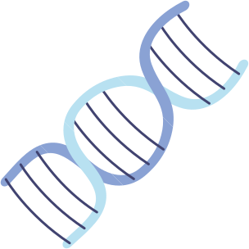




Brain Tumor Detection

Slide 2
Presented by
Department : CSE-AIML (B)
Session : 2024- 25
Faculty : Abhishek Shukla
Prathvi Raj Chauhan 202401100400145
Isha Tyagi 202401100400100
Naitik Kukreja 202401100400120
Prashant Rajput 202401100400141
Deepak Kumar 202401100400076

Slide 3

Problem
Statement
This project uses convolutional neural networks(CNN) to classify Brain Tumor.
Dataset sourced from Kaggle with labeled MRI images.
Brain Tumor Detection
using Conventional Neural Network (CNNs)

Slide 4
What is Brain Tumor ?
Brain Tumor Basics
Early Detection
A brain tumor is an abnormal growth of cells in or around the brain. These cells can multiply uncontrollably, forming a mass that can interfere with normal brain function.
Improves treatment options and survival rates.

Slide 5
Overview 01
Late Diagnosis.
Many tumors are detected at advanced stages due to subtle or no early symptoms.
Shortage of Expert Radiologists.
Global Health Challenges
Overview 02
Costly and Time-consuming Scans
Diagnostic Errors & Human Fatigue

Slide 6
What is CNN?
A Convolutional Neural Network (CNN) is a deep learning model specially designed for image analysis. It automatically learns to identify patterns, textures, and structures in images.
Widely Used in Medical Imaging
CNNs are extensively used in medical fields for tasks like:
Brain tumor detection
Lung disease diagnosis
Retinal image analysis
ADVANTAGES OF CNN
High accuracy in detection and classification.
Reduces human error and fatigue.
Scalable and efficient once trained.
Capable of working with large medical image datasets.

Slide 7
Role of CNNs
CNN role in brain tumor detection
1. Image Preprocessing
2. Feature Extraction
3. Tumor Classification
4. Tumor Segmentation
5. Early Diagnosis
Convolutional Neural Networks (CNNs) play a crucial role in brain tumor detection, especially using medical imaging like MRI scans

Slide 8
Dataset Overview
Data set is taken from kaggle
it is labelled dataset with images labelled with yes and no about the tumor presence in the brain
The images are of MRI scan of different Human brains,
It is trained on total of 253 images.

Slide 9
Methodology
CNN Model Design
Convolutional, pooling, and dense layers with ReLU and Sigmoid activations.
Preprocessing
Resize and normalize MRI images for consistency.
Training Setup
80/20 split, (80% - X_train, Y_train) & (20% - X_temp & y_temp)

Slide 10
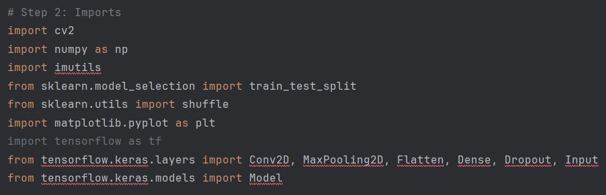
LIBRARIES INCLUDED

Slide 11
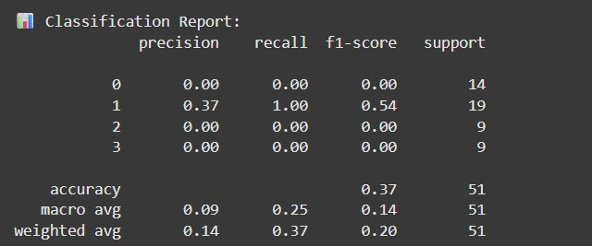
OUTPUT

Slide 12
Future Implementations
Real -Time Clinical Decision Support
CNNs can assist doctors in real time by analyzing MRI scans during patient visits.
This speeds up diagnosis and helps in making faster, data-driven treatment decisions.
3D Tumor Segementation
CNNs can create detailed 3D models of brain tumors from multiple MRI slices.
This helps surgeons accurately plan operations and track tumor growth over time.

Slide 13
Conclusion
KEY POINTS
CNN offer powerful solution through:
Early detection
Accurate classification
Precise 3D segmentation
Real-time clinical support
Brain tumors are a serious global health challenge requiring fast and accurate diagnosis.
Traditional methods face issues like delayed detection, limited expert availability, and diagnostic errors.

Slide 14
Thank you for your attention

